Slide 1
Arrays and Array Lists
CS 21a: Introduction to Computing I First Semester, 2016-2017

Slide 2
Problem 1: Reversing Input
Problem: Read in three numbers then print out the numbers in reverse order.
Straightforward Java application
declare three variables of type double
read in the values using the Scanner object
print them out starting with the last variable read in
public static void main(String args[]) {
Scanner in = new Scanner(System.in);
System.out.println("Numbers: ");
double num1, num2, num3;
num1 = in.nextDouble();
num2 = in.nextDouble();
num3 = in.nextDouble();
System.out.println("Reverse: ");
System.out.println( num3 );
System.out.println( num2 );
System.out.println( num1 );
}

Slide 3
Generalizing a Problem
Suppose we wanted the same program but wanted 10 instead of 3 numbers?
Suppose we wanted to read in 1000 numbers?
We would have more than 3000 lines of code if we used the same approach
Solution: arrays

Slide 4
Arrays
A collection of elements of the same type
Each element is accessed through an index
In Java
declaration: double[] nums;
creation: nums = new double[8];
usage: nums[3] = 6.6;
Note: starting index is 0
double nums[] is also legal, but double[] nums is preferred, since it emphasizes that the type is double[] ("double array" or "array of doubles")

Slide 5
Visualizing an Array
nums
null
Declare: double[] nums;

Slide 6
Visualizing an Array
0 | 0.0
1 | 0.0
2 | 0.0
3 | 0.0
4 | 0.0
5 | 0.0
6 | 0.0
7 | 0.0
nums
Declare: double[] nums;
Create: nums = new double[8];

Slide 7
Visualizing an Array
0 | 0.0
1 | 0.0
2 | 0.0
3 | 6.6
4 | 0.0
5 | 0.0
6 | 0.0
7 | 0.0
nums
Declare: double[] nums;
Create: nums = new double[8];
Usage: nums[3] = 6.6;

Slide 8
Reversing 10 Numbers
Use an array
Declare double[] nums
Create new double[10]
Use indices 0, 1, 2,... when referring to the different array elements
Statements still look redundant (how about using loops?)
public static void main(String args[]) {
Scanner in = new Scanner(System.in);
System.out.println("Numbers: ");
double[] nums;
nums = new double[10];
nums[0] = in.nextDouble();
nums[1] = in.nextDouble();
nums[2] = in.nextDouble();
...
System.out.println("Reverse: ");
...
System.out.println( nums[2] );
System.out.println( nums[1] );
System.out.println( nums[0] );
}

Slide 9
Reversing 10 Numbers
Use arrays and loops
Declare double[] nums
Create new double[10]
Use a for loop to read in the numbers
Use another for loop to print them out in reverse
public static void main(String args[]) {
Scanner in = new Scanner(System.in);
System.out.println("Numbers: ");
double[] nums;
nums = new double[10];
for( int i = 0; i < 10; i++ ) {
nums[i] = in.nextDouble();
}
System.out.println("Reverse: ");
for( int i = 9; i >= 0; i-- ) {
System.out.println( nums[i] );
}
}

Slide 10
Scaling Up
What if we want to change the number of elements?
We would have to find and change all lines using 10 (including the 9 in the for loop)
Very tedious and error prone
public static void main(String args[]) {
Scanner in = new Scanner(System.in);
System.out.println("Numbers: ");
double[] nums;
nums = new double[10];
for( int i = 0; i < 10; i++ ) {
nums[i] = in.nextDouble();
}
System.out.println("Reverse: ");
for( int i = 9; i >= 0; i-- ) {
System.out.println( nums[i] );
}
}

Slide 11
Scaling Up
Use a constant to indicate the array size
Use that constant in the for loops
Only need to change one portion of the program when scaling up
private static final int MAX = 3;
public static void main(String args[]) {
Scanner in = new Scanner(System.in);
System.out.println("Numbers: ");
double[] nums;
nums = new double[MAX];
for( int i = 0; i < MAX; i++ ) {
nums[i] = in.nextDouble();
}
System.out.println("Reverse: ");
for( int i = MAX-1; i >= 0; i-- ) {
System.out.println( nums[i] );
}
}

Slide 12
Constants and "Magic Numbers"
Constants are useful for "magic numbers", i.e., specific values that are used throughout the code
e.g. MAX_LENGTH, SCREEN_WIDTH, PI, BLUE, DASHED_LINE, etc.
Useful because:
makes code more readable and maintainable
e.g. WHITE is easier to understand and remember than 255
makes modifications easier
in the reversing program example, we only need to change MAX, no need to look for 10 and 9

Slide 13
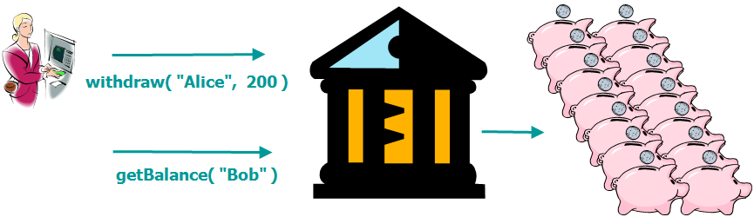
Problem 2: Collection of Objects
How can we write Bank so it can handle a larger number of BankAccounts?
Right now, we can only handle a small number of accounts ( 2 or 3)

Slide 14
Solution: Array of Objects
Declaration BankAccount[] accounts;
Creation of the array accounts = new BankAccount[5];
creates an array of references to BankAccounts
but no actual BankAccounts yet
Creation of Objects for( int i = 0; i < 5; i++ ) accounts[i] = new BankAccount();
creates the BankAccounts themselves and assigns these to the references

Slide 15
Visualizing an Array of Objects
accounts
null
Declare: BankAccount[] accounts;

Slide 16
Visualizing an Array of Objects
0 | null
1 | null
2 | null
3 | null
4 | null
accounts
Declare: BankAccount[] accounts;
Create: accounts = new BankAccount[5];

Slide 17
Visualizing an Array of Objects
BankAccount balance
0
BankAccount balance
0
1
2
3
4
10
accounts
BankAccount balance
20
BankAccount balance
30
BankAccount balance
Declare: BankAccount[] accounts;
Create: accounts = new BankAccount[5];
Create objects: for( int i = 0; i < 5; i++ )
accounts[i] = new BankAccount(i * 10);
40

Slide 18
Visualizing an Array of Objects
BankAccount balance
0
BankAccount balance
0
1
2
3
4
10
accounts
BankAccount balance
20
BankAccount balance
30
BankAccount balance
Declare: BankAccount[] accounts;
Create: accounts = new BankAccount[5];
Create objects: for( int i = 0; i < 5; i++ )
accounts[i] = new BankAccount(i * 10);
Usage: accounts[3].getBalance(); // 30
40

Slide 19
Approach
Include an acctName field in BankAccount
Add a constructor that allows you to indicate name and balance
Add a getAcctName() method
Declare an array of BankAccount objects in Bank
Create the array inside Bank's constructor
Loop through the array to find a matching account before carrying out the transaction (deposit, withdraw, getBalance)

Slide 20
Approach
A field representing the account name (acctName)
Constructor that accepts a name and an initial balance
"get" method to access acctName
public class BankAccount {
private double balance;
private String acctName;
...
public BankAccount( String name, double initBal ) {
acctName = name;
balance = initBal;
}
...
public String getAcctName() {
return acctName;
}
...
}

Slide 21
Approach
A field representing an array of BankAccounts (accounts)
There is also a constant representing the maximum amount of BankAccounts the bank can handle (MAX)
The array is initialized in the constructor. It is also populated with two BankAccount objects ("john" and "marsha")
public class Bank {
private BankAccount[] accounts;
private static final int MAX = 10;
public Bank() {
accounts = new BankAccount[MAX];
accounts[0] = new BankAccount("john", 100);
accounts[1] = new BankAccount("marsha", 200);
}
}

Slide 22
The deposit Method
First, loop through the accounts array to find a matching BankAccount object
The getAcctName() method is used to get the name of an account and compare it with the name argument passed
public class Bank
{
...
public void deposit(String name, double amt)
{
BankAccount temp = null;
for(int x=0; x<MAX; x++)
{
if(accounts[x].getAcctName().equals(name))
{
temp = accounts[x];
}
}
if( temp != null )
temp.deposit(amt);
}
}

Slide 23
The deposit Method
First, loop through the accounts array to find a matching BankAccount object
The getAcctName() method is used to get the name of an account and compare it with the name argument passed
public class Bank
{
...
public void deposit(String name, double amt)
{
BankAccount temp = null;
for(int x=0; x<MAX; x++)
{
if(accounts[x].getAcctName().equals(name))
{
temp = accounts[x];
}
}
if( temp != null )
temp.deposit(amt);
}
}
Be careful when writing code like this. Doing this gives a NullPointerException if no BankAccount instance is assigned to that location.

Slide 24
The deposit Method, version 2
public class Bank {
...
public void deposit(String name, double amt) {
BankAccount temp = null;
for( int x = 0; x < MAX; x++ ) {
if( accounts[x] != null ) {
if( accounts[x].getAcctName().equals(name) ) {
temp = accounts[x];
}
}
}
if( temp != null )
temp.deposit( amt );
}
...
}
Check first if the location contains an instance of BankAccount(i.e., not null)

Slide 25
The deposit Method, version 3
public class Bank {
...
public void deposit(String name, double amt) {
BankAccount temp = null;
for( int x = 0; x < numAccounts; x++ )
{
if( accounts[x].getAcctName().equals(name) )
temp = accounts[x];
}
if( temp != null )
temp.deposit( amt );
}
...
}
Another alternative is to change the limit of x to the actual number of accounts that the array contains.

Slide 26
Approach
What is the value of numAccounts?
public class Bank {
private BankAccount[] accounts;
private static final int MAX = 10;
private int numAccounts = 0;
public Bank() {
accounts = new BankAccount[MAX];
accounts[0] = new BankAccount("john",100);
accounts[1] = new BankAccount("marsha",200);
numAccounts = 2;
}
...
}

Slide 27
Creating new BankAccounts
public void openAccount(String name, double initBal)
{
if( numAccounts < MAX )
{
accounts[numAccounts] = new BankAccount(name, initBal);
numAccounts++;
}
else
{
System.out.println("Maximum number of accounts reached");
}
}

Slide 28
Using openAccount as a Convenience
In the Bank's constructor
public class Bank {
...
public Bank()
{
accounts = new BankAccount[MAX];
openAccount("john", 1000);
openAccount("marsha", 2000);
}
}
Better yet, make calls to openAccount from the driver program so that a newly created Bank object contains no accounts.

Slide 29
The withdraw Method
public class Bank
{
...
public void withdraw( String name, double amt ) {
BankAccount temp = null;
for( int x = 0; x < numAccounts; x++ )
{
if( accounts[x].getAcctName().equals(name) )
temp = accounts[x];
}
if( temp != null )
temp.withdraw( amt );
}
...
}
Notice that the code is almost identical to the code in the deposit method, except for the last line.
How do we eliminate this redundancy?

Slide 30
The findAccount Method
public class Bank
{
...
private BankAccount findAccount( String name )
{
for( int x = 0; x < numAccounts; x++ )
{
if( accounts[x].getAcctName().equals(name) )
return accounts[x];
}
return null;
}
...
}
This method can be called from deposit, withdraw, and getBalance.

Slide 31
Using findAccount
public class Bank
{
...
public void deposit( String name, double amt ) {
BankAccount temp = findAccount( name );
if( temp != null )
temp.deposit( amt );
}
public void withdraw( String name, double amt ) {
BankAccount temp = findAccount( name );
if( temp != null )
temp.withdraw( amt );
}
...
}
Write the code for the getBalance method on your own.

Slide 32
More about Arrays
Arrays are objects
the array variable is just a reference to the actual array that contains the values
need to use "new" after declaring
passed as a reference when used as method parameter
Special features
the public final int length field returns the array size
in the example, accounts.length returns 10
[] operator only works with arrays

Slide 33
More about Arrays
ArrayIndexOutOfBounds exception
valid indices for array of size n: 0 to n-1
any access to other indices causes an error
Array size can't be changed after the array is created
To expand the array, we need to create a new array, copy the old array's contents, then point the array variable to the new array

Slide 34
Array Initializers
You can initialize an array with the following syntax: String[] responses = {"Hello", "Hi", "OK"};
Can be used for fields, local variables, and even constants

Slide 35
Useful Pattern
Put different responses for different cases in an array String[] responses = {"Hello", "Hi", "OK"};
Assign an integer to represent different cases
In this case 0 means the program will say "Hello", 1 means it will say "Hi", etc.

Slide 36
Useful Pattern
Now, you can generate the data for each case accordingly
What does the following code do?
int greetingCase = (int)(Math.random() *
responses.length);
String greeting = responses[greetingCase]
+ "World";
System.out.println( greeting );

Slide 37
Command Line Arguments
Try this program
public class Command {
public static void main(String[] args) {
System.out.println( "Hi, " + args[0] );
}
}
Execute the program outside of BlueJ, through the command line
C:\...\> java Command bob Hi, bob

Slide 38
Command Line Arguments
The String[] args parameter in the main program represents the words you specify in addition to the java and the program name (e.g. Command)
args[0] refers to the first argument, args[1] refers to the second argument, and so on...
Use args.length to find out how many arguments are indicated
In BlueJ, when you right-click on the Java class and execute main, you may include arguments as well.

Slide 39
Multi-dimensional Arrays
A natural extension of simple (1D) arrays
2D declaration: char[][] grid;
think "array of arrays"
Array creation grid = new char[10][20]; //10 rows, 20 cols
Another way grid = new char[10][]; //creates array of 10 char[]'s for( int i = 0; i < 10; i++ ) grid[i] = new char[20]; //creates a size-20 array
This way allows for varying row sizes

Slide 40
Visualizing 2D Arrays
char[]-type references
0
1
2
3
4
 |  | C
char[][]
Declare: char[][] grid;
Create rows: grid = new char[5][];
Create columns:
for( int i = 0; i < 5; i++ )
grid[i] = new char[3];
Use objects: grid[3][2] = 'C';

Slide 41
Using 2D Arrays
To refer to an individual element, use two indices, e.g. grid[2][1] = 'X';
Using only one index refers to a single dimensional array
e.g. grid[4] refers to row 5
grid[4].length is the length of row 5 (in this case, the length of row 4 is 3)
The array variable by itself refers to the top-level array (the array of rows)
grid.length is the length of the array of rows, i.e., it's the number of rows

Slide 42
Problem 3: Flexible Collections
How can we write Bank so it can handle an arbitrary number of BankAccounts?
Right now, with arrays, we can only handle a fixed number of accounts (up to MAX)

Slide 43
The Java Collections Framework
A set of classes that you can use for containing arbitrarily large collections of objects
To use, you must place import java.util.*; at the top of your code
Some basic Collections classes
ArrayList, Vector
HashMap, Hashtable

Slide 44
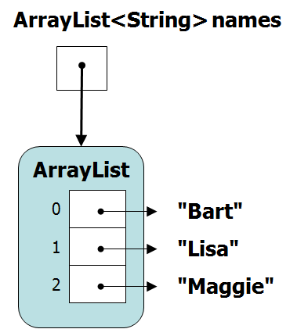
ArrayList
Indexed list of objects that automatically resizes
The list is ordered, with each object in the list having an index, from 0 to n-1
Most commonly used methods
boolean add( E element)
int size()
E get( int index )
E set( int index, E element )
and many many others (see API docs)

Slide 45
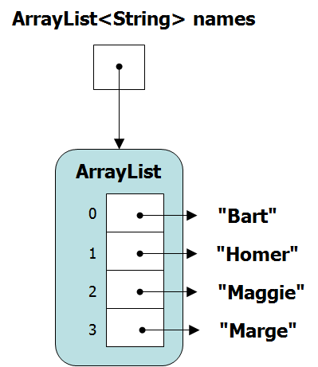
ArrayList Example
You have to specify the type of object it has to store.
import java.util.*;
public class ArrayListDemo
{
public static void main(String[] args)
{
ArrayList<String> names
= new ArrayList<String>();
names.add("Bart");
names.add("Lisa");
names.add("Maggie");
for(int i=0; i<names.size(); i++)
System.out.println(names.get(i));
names.set(1,"Homer");
names.add("Marge");
for(int i=0; i<names.size(); i++)
System.out.println(names.get(i));
}
}

Slide 46
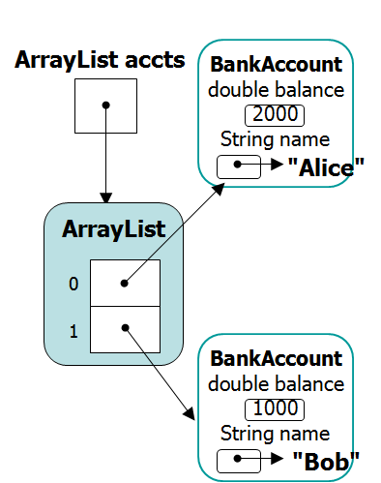
Using Other Types
import java.util.*;
public class ArrayListBank
{
public static void main(String[] args)
{
ArrayList<BankAccount> accts
= new ArrayList<BankAccount>();
accts.add(new BankAccount("Alice",2000));
accts.add(new BankAccount("Bob",1000));
for(int i=0; i<accts.size(); i++)
{
BankAccount current = accts.get(i);
System.out.println("Bank Account #" + i
+ "Owner: " + current.getAcctName()
+ ", Balance: " + current.getBalance() );
}
}
}

Slide 47
Looping through ArrayLists
Using an index… for(int i=0; i<accts.size(); i++) { BankAccount current = accts.get(i); System.out.println(...); }
Using an "enhanced for"... for( BankAccount b : accts ) System.out.println( b.getBalance() );
Simpler than a regular for loop. All you have to specify is the object (BankAccount) and the ArrayList (accts).

